Slide 1

Est. May 2020
We are a highly skilled consortium of geologists, geophysicists, engineers, geographers, and IT gurus, who have deep experience and demonstrable accomplishment in their respective disciplines.
Working individually or deployed in teams, our associates and affiliate partners bring an innovative mindset, critical problem-solving skills, and an arsenal of best practices developed over their successful careers.
We work projects in the energy upstream and midstream space, as well as provide services and consulting to the environmental, construction, real estate, utilities, renewables, and banking sectors.

Slide 2
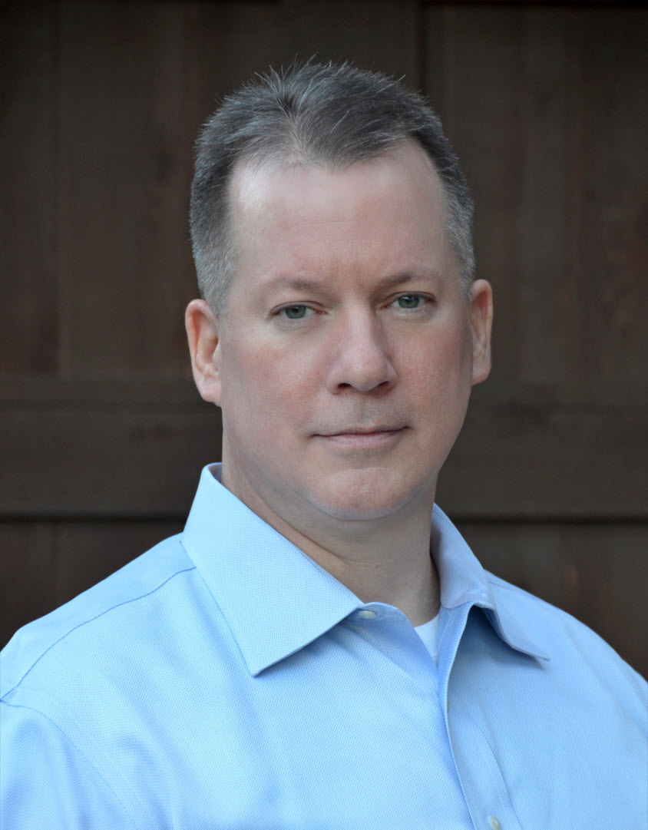


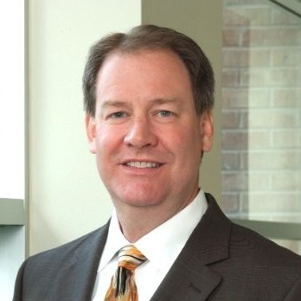
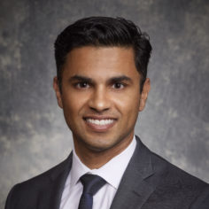
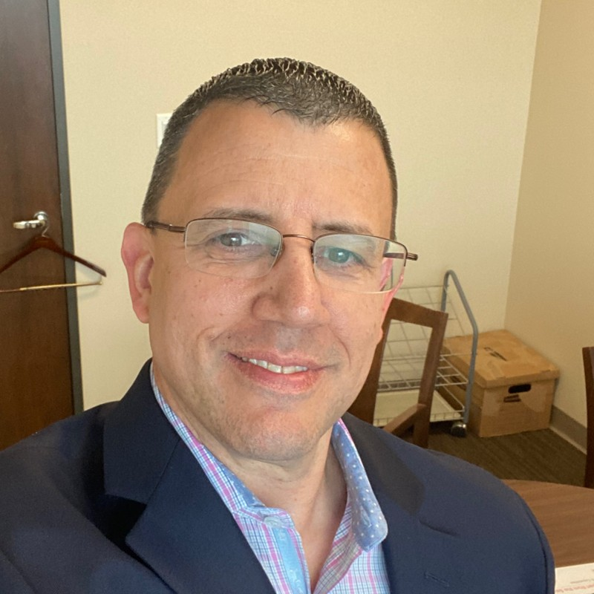
EXPERIENCE
Founder | Chief Executive Officer – Wheelhouse Geoscience, LLC
Founder | Chief Executive Officer – HomeWorld Educational Resources
Chief Geologist – Yates Industries
Co-founder | Vice President, Geosciences – Monadnock Resources
Vice President, Geosciences – Forge Energy
Senior Geoscientist – Pioneer Natural Resources
Division Geologist – Martin Marietta Materials Company
CERTIFICATIONS
Licensed Professional Geoscientist, No. 15612, State of Texas Board of Professional Geoscientists
Certified Petroleum Geologist, No. 6117 – AAPG, DPG
Certified Professional Geologist, No. 11773 – AIPG
Certified Professional Earth Scientist, No. 3530 – SIPES
Graduate Certificate in Geographic Information Systems – UT Dallas
EDUCATION
MS, Geosciences – The University of Texas at Dallas
MS, Geographic Information Sciences – The University of Texas at Dallas
BS, Geosciences – The University of Texas at Dallas
Colleagues. Collaborators. Subcontractors. Friends and Family. And, especially, our Clients.
From the very beginning and every day over these last 5 years, it’s the passion, expertise, and professionalism of the people that Wheelhouse has the pleasure of working with and working for that makes it worth it.
Wheelhouse is all about people. People’s collective influence and potential brought to bear. People solving problems. People creating value.
Larissa Williamson
Bill Bahlburg
Brandon Greiss
Clay Snyder
Darrell Narron
Darrick Stallings
David Mitchell
Frank Yates
Gordon Jenner
Jason Maloy
Jeevak Mattamana
Jordan Noret
Joshua Christiansen
Kelli Roach
Kent Bowker
Lori Murray
Ning Wang
Niranjan Aryal
Ramiro Saavedra
Rod Kuseski
Tate Savage
Violeta Lujan
Wesley Adams
“Yates Industries has been working with David and his Wheelhouse team for about five years now. They have helped us with everything from reservoir characterization to operational planning to business development. That collaboration has had a positive, tangible impact on our organization. I wholeheartedly recommend Wheelhouse Geoscience to anyone who needs to leverage talent and experience to further their project’s success.”
– Darrick Stallings, President Oil & Gas, Yates Industries, LLC
Sherrie Cawthon
Colleen Donegan
Blake Gillespie
Kevin Hiss
Joshua Hughes
Vishal Kaul
Keith Kimme
Jeni Kuseski
Lowell Waite
Black Mountain Sand
CarbonCycle
Cowboy Clean Fuels
Energy Advisors Group
Grey Rock Investment Partners
Hominy Consulting
Kbros Technosoft Solutions
Longfellow Energy
Pineland Energy
Positano Analytical Resources
RedOaks Energy Advisors
Rising Star Energy Partners
Schlumberger
Scout Energy Management
TenOaks Energy Advisors
The University of Texas at Dallas
Triple Oaks Royalty
Yates Industries
“Wheelhouse Geoscience has done a variety of different projects for TenOaks. This includes well level work all the way to basin-wide field studies. Their attention to detail and the ability to meet tight deadlines has allowed TenOaks to maintain the high quality of standards that we have come to expect. They also have the ability to draw upon a deep bench of technical and geological knowledge that allows us to trust them with any of our geologic needs.”
– Jeevak Mattamana, Partner – Engineering, TenOaks Energy Advisors, LLC
“I highly recommend Wheelhouse Geoscience. I recently worked on a project with them, and they were able to make geological information very simple and concise, so the average person could understand.”
– Wesley Adams, Vice President, Energy Advisors Group, Inc.

Slide 3

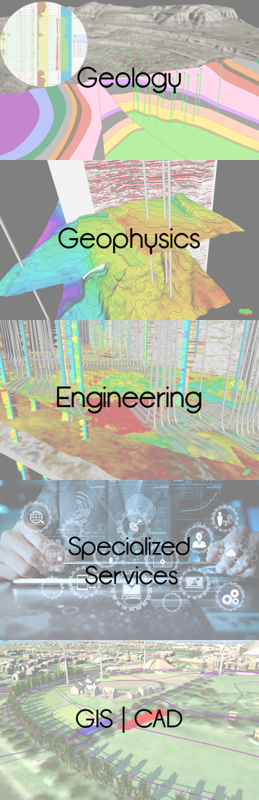
Full scope buyer-side and seller-side technical evaluations: geologic and engineering due diligence; asset valuation; risking; upside characterization and vetting; exhibit preparation. Over 90 evaluations since inception.
Cradle to grave wellbore planning and execution: play fairway analysis; geologic prognoses; operations geology; casing point election assessment; post-mortem and reservoir modeling refinement.
Geosteering: We plan and geosteer horizontals, with experience in complex geologic environments. Our industry-best geosteering guru pioneered the practice of 'retroactive batch geosteering' to enhance reservoir characterization, offers tailored in-house geosteering courses, and is presently creating a comprehensive online on-demand course to be taught through a leading continuing ed vendor.
Wheelhouse has also contributed its expertise to Energy Transition projects, including carbon capture & sequestration (CCS), renewable natural gas (RNG), and lithium extraction.
Exploration
Integrated multidisciplinary play and prospect evaluation
Prospect to regional reservoir and structural characterization
Seismic and attribute analysis interpretation
Well log petrophysics and pay estimation
Geological and economic risk assessment
Exploration economics and decision tree analyses
Development and Production
Drilling and completion
Integrated reservoir characterization
Development, infill, and workover locations, proposals, and audits
Decline curve analysis reserves classification and auditing
Development plans, CapEx/OpEx determination and benchmarking
Field operations management
Production optimization economics
M&A&D Consulting to Companies, Private Equity and Support to Banks, Law Firms and Accountancies
Strategic trends and competitive position analyses
Technical and commercial due diligence
Independent risked valuations and calibration to benchmarks
Buy-side company liaison in data rooms
Sell-side marketing, including VDR / technical presentation preparation
Data Analytics
Cost-effective hardcopy/raster data conversion to standardized digital format
Capture and transform oilfield data into business problem solving tools
Full-range GIS services
Strategy and Portfolio
Corporate growth strategy, gap identification
Exploration portfolio analyses, risk, high-grading and valuation, farmin/farmout strategy and structuring
Production portfolio analyses and valuation, realignment, rationalization, and growth
High-grading of investment opportunities, and capital strategy
We do not over-promise and under-deliver.
Being on the same page about expectations is crucial: We make no assumptions and ask questions (and are always open to yours). Being a generalist gets someone only so far; we pull in specialists-by-discipline as needed to tackle the tough stuff. We charge hourly rather than by the day or the project, because we want the work to dictate what “completion” looks like, not the clock.
We do not bite off more than we can chew.
We are a boutique consultancy. We know we’re at our best when we provide a lot of service to a few clients rather than providing light service to a lot of clients. If we do not have the bandwidth to tackle your needs, we are honest about it. Time is money, and we won’t waste yours.
We do not abuse our client’s hard-earned trust.
No price gouging: Our rates are fair, and our invoices are transparent. Our client’s data, activities, and plans are kept confidential. Our clients are entitled not only to the final product but also to the data and analytics behind it. We make recommendations thoughtfully, just as if it was our company and our money on the line.

Slide 4
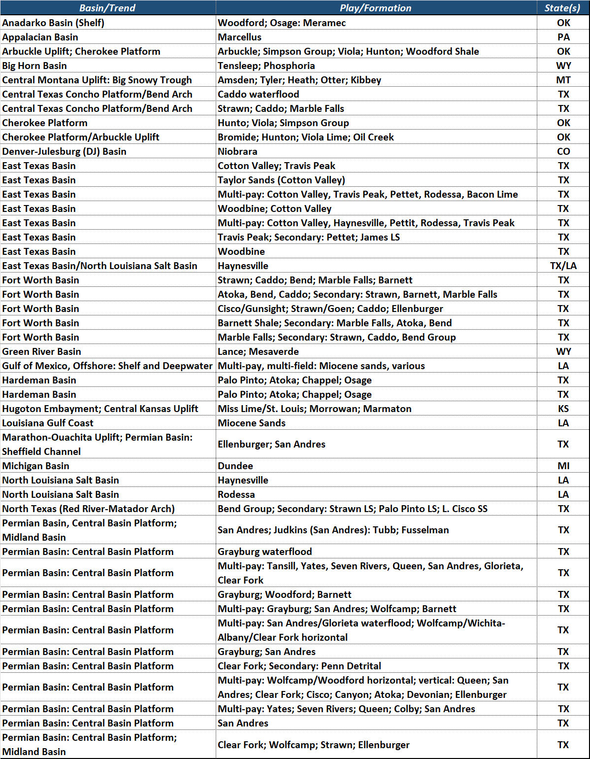
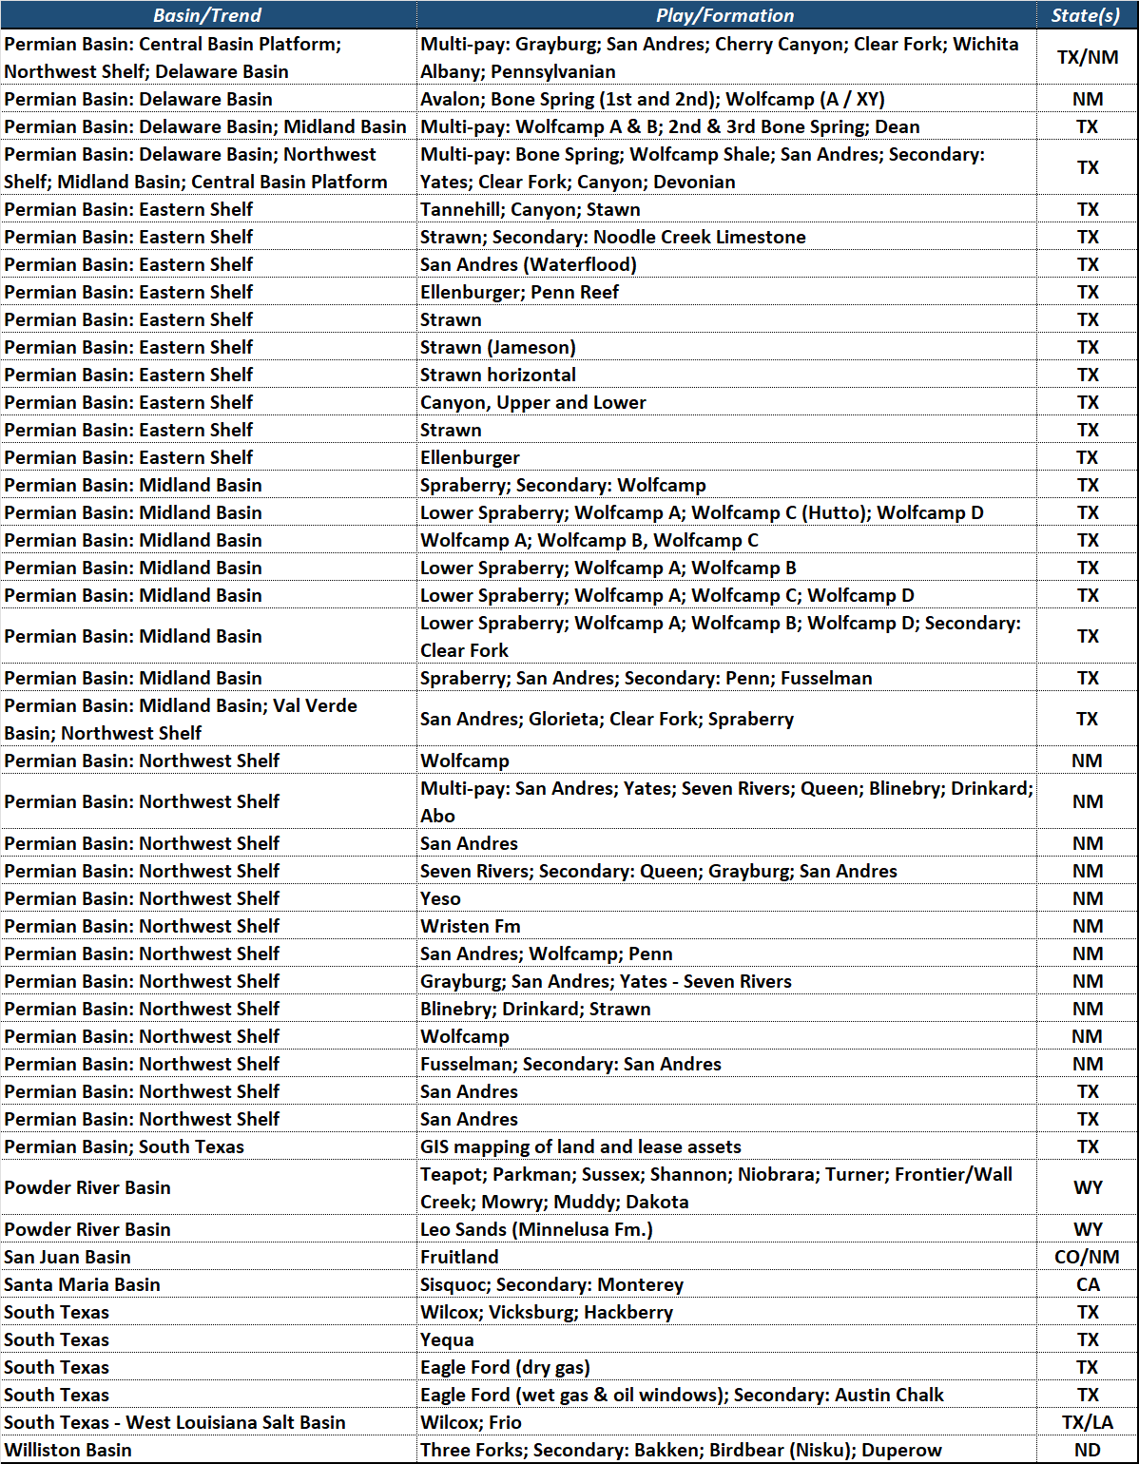
Over 90 buyer-side and seller-side technical evaluations since inception.
From quick-look appraisals to comprehensive reservoir characterization and valuation.

Slide 5
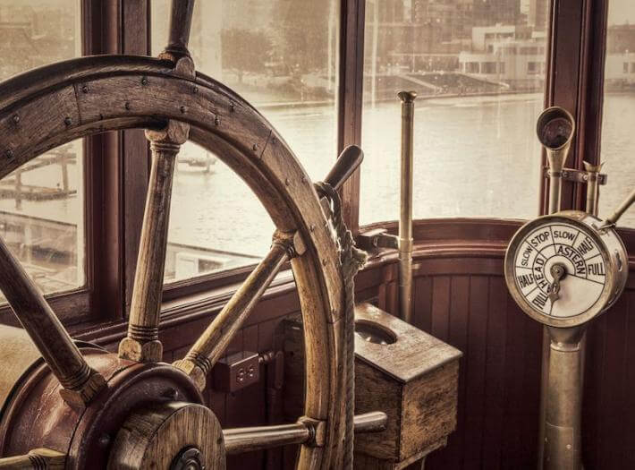
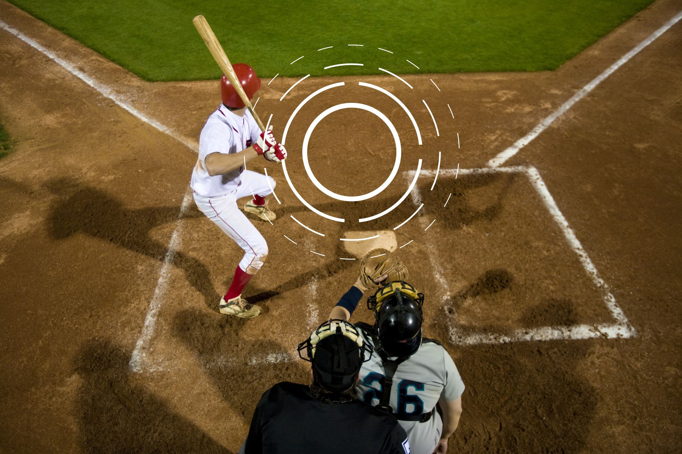


The term “wheelhouse” appeared for the first time in the early 1800s to describe the pilothouse on a boat or ship.
The experienced, steadfast captain has been a revered symbol in literature and lore for centuries. An example is the poem, “O Captain! My Captain!,” by Walt Whitman, which is an ode to the great President Lincoln shortly after his death. Whitman admired Lincoln greatly and thought of him as the captain who had navigated America through some of its darkest, most treacherous seas. A passage from his poem captures this symbolism eloquently:
“The ship is anchor’d safe and sound, its voyage closed and done, From fearful trip the victor ship comes in with object won….”
“Baseball and apple pie” – Nothing is more quintessentially American than the imagery these invoke.
It was in the 1950s, when baseball announcers and reporters started referring to a batter’s “wheelhouse” as the area of the strike zone where a batter swings with the most power. Reporters also called this area the “crush zone” and the “kill zone”. In this fashion, the batter can tell from the moment the ball leaves the pitcher’s hand that it’s headed for his sweet spot…he knows in that moment that he’s going to swing for the fences, connect, and score.
That feeling, which can only come from experience and intuition, is bliss.
Not surprisingly, that “sweet spot feeling” when all the pieces come together and one’s expertise is able to shine found its way into business jargon beginning in the 1980s.
In this new, figurative sense, “wheelhouse” means “the field in which a person excels; one’s strongest interest or ability.” (Oxford English Dictionary)
Steadfast. Intuitive. Skilled. Experienced.
These are the hallmarks that define us here at Wheelhouse Geoscience.
When you place your project in our hands, rest assured we will deliver for you. After all, it’s in our Wheelhouse.
Our global community is often volatile, with periods of prosperity and calm intermingled with economic and geopolitical challenges. Nowhere is this reflected more than in historical oil commodity prices, as shown here.
In times of economic volatility, companies with vision see opportunity. Applying best-in-class expertise, they not only survive…they thrive.
It’s in that spirit that Wheelhouse Geoscience applies time-proven best practices while remaining on the cutting edge, allowing us to assist our clients to stand out and to prosper.
So, what’s in a name? Our reputation. Our promise.
140
120
100
80
60
40
20
1840
1850
1860
1870
1880
1890
1900
1910
1920
1930
1940
1950
1960
1970
1980
1990
2000
2010
2020
Oil prices adjusted to 2014 dollars

